Slide 1
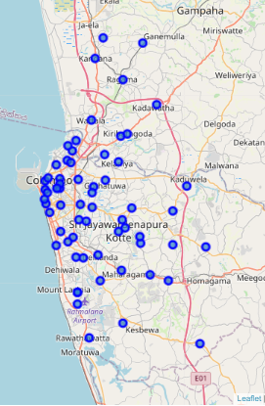
Finding the Ideal Suburb for a Pizzeria in Colombo
Rayantha sinnathamby

Slide 2
What is the aim?
Find
Find a group venues by type for Colombo Suburbs.
Pick
Pick the best types of venues to indicate incentivize restaurant spending.
Group
Group neighborhoods based on landscape of venue types.
Create and compare
Create and compare metrics to identify best neighborhoods.
Determine
Determine the ideal neighborhood among them based on cluster properties.

Slide 3
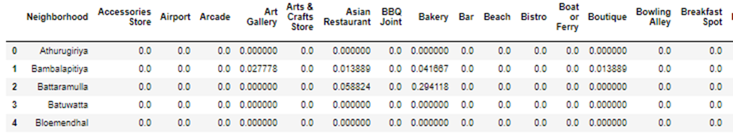
Data and Cleaning
Suburb data was obtained from Wikipedia, geocoded and Four-Square API used for getting venue details in each suburb.
Data was one hot encoded based on venue type, most appropriate variables selected, and normalized

Slide 4
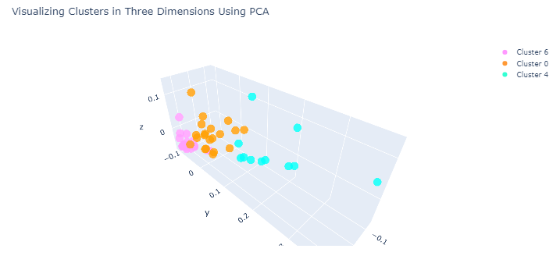
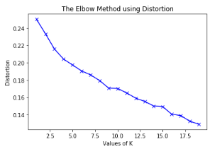
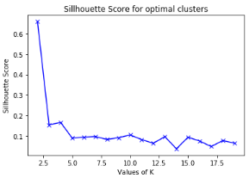
Getting the K in K means!
Many tests were carried out using elbow plots silhouette scores and principle component visualizations to arrive at K=8 based on cluster seperation

Slide 5
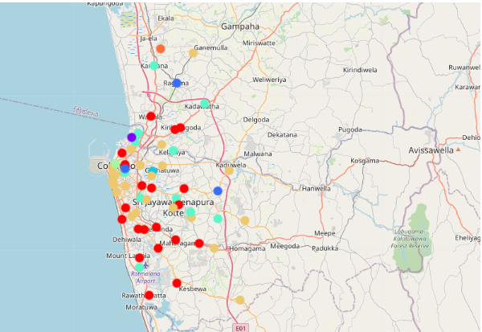
Clusters mainly based on proximity and activity
The three largest clusters show separation between the heart of the city. Suburbs in close proximity to busy travel routes and outer suburbs filled with residences and businesses alike.

Slide 6
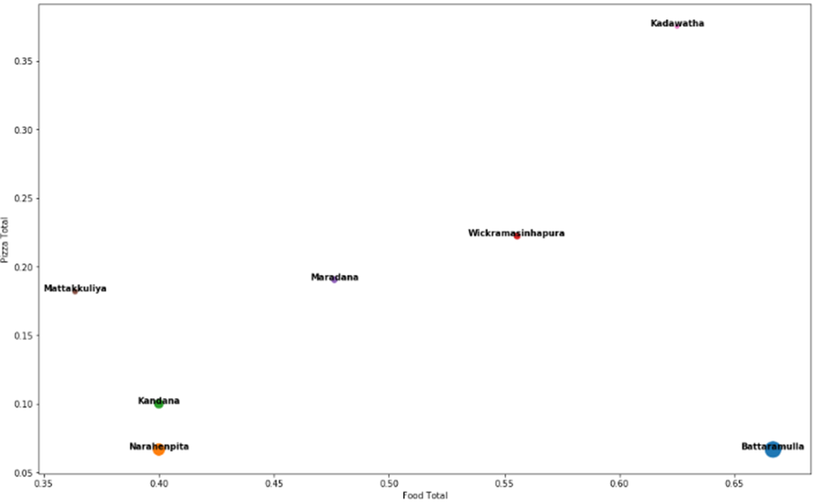
Suburb chosen based on cluster properties and demand for Pizza
The demand for Pizza was calculated by cluster based on presence of food v.s. presence of pizza related venues in a neighborhood.
In the highly active cluster 4 Battaramulla emerged having a high demand for food but not enough pizza being supplied.
Battaramulla

